Slide 1
Leveraging LLMs to Handle Code Comprehension Tasks
Ben Herdman

Slide 2
Motivation
Suppose you have some uncommented/undocumented code you have to review. If you could add one piece of documentation to each function/method, what would you add?
  This could be one comment to a specific line, a partial docstring for one variable, etc.
Imagine another scenario, you have to work quickly with a new codebase you aren’t familiar with. What would be the quickest way to understand each function/method without reading it?
Conversely, what if you have written code and commented it, but are unsure if your comments are correct?
Notes:
My interest started when, during an assignment this semester, I had to spend quite a bit of time researching Java. I can't remember which assignment it was, but it was the one where you had to generate the weakest possible pre-condition for a java func. I had to research some of the exceptions that can happen. I initially answered the question to ensure that NaN was not encountered, but I learned that wasn’t technically an exception.
This piqued my interest because I had to spend a decent chunk of time on learning this, I wondered how easy it would be for ChatGPT to answer it?
My goal is to get you to think in terms of wanting to speed things up, not a matter of I can’t do this

Slide 3
Problem
Let's focus on one type of code comprehension we worked on this semester, pre- and post-conditions.
Specifically, how well can LLMs find and document these conditions?
  Models/LLMs used: ChatGPT 4.0 and Copilot
  Further analyzed how well the models convert the post-conditions to executable format.
Additionally, how well can they assess correctness of already written pre- and post-conditions?
Notes:
Many articles, books, etc. in our field tell us that testing, comments, and other related topics are often neglected until last. That hasn’t exactly been my experience, but I can believe it at larger companies.
So, here is what we are going to work on: Given a class/block of code, how well can these LLMs find and add pre- and post-conditions to an existing/nonexistent docstrong
How do they perform when evaluating already written conditions i.e. evaluating each others pre- and post-conditions.

Slide 4
Methodology – Prompt 1
According to the Tiobe Index, Python is still the most used programming language.
A rather basic data structure is a linked list and there are most likely plenty of examples for the LLMs to reference.
Asked both models to find the pre- and post-conditions for each method in the linked list.
Notes:
We use python because it is everywhere, we use a linkedlist because it is an easy ds the models can quicly reference
So, combining Python, linked lists, and ChatGPT/Copilot, we have to design a prompt to get what we need out of the models.
Basically, I asked the model to find the pre and post condition for each method in the code and add it to the docstring, then convert the post-conds to executable format.
Relatively basic, and it performed as such.
So a burning question in some minds might be, why Copilot? There are better models and given the recent news, it seems Copilot is not performing well comparatively. Well, Copilot is heavily integrated into all Microsoft products, its hard to deny the accessibility it provides when other models are blocked. A previous job I held blocked everything except copilot.

Slide 5
Methodology – Prompt 2
Similar setup as prompt 1, except we use a more robust prompt.
  Specifically, this prompt includes examples, definitions, exact details of what is wanted, very specific wording so the model can retrieve associated data, etc.
Additionally, the models were asked to breakdown the analysis by each method, as opposed to analyzing the entire codebase at once.
Notes:
For point 2, as opposed to the entire codebase being analyzed at once

Slide 6
Methodology – Review Each Other
After each prompt, the models swapped code and evaluated the correctness.
For example, ChatGPT is asked to add pre- and post-conditions to the linked list. After generating it, the response was fed to Copilot and asked to evaluate the correctness of the pre- and post-conditions in the docstring.
Unfortunately, the results were not interesting. Without fail the models were able to correctly identify a correct or incorrect pre- or post-condition.
Notes:
For point 3, or perhaps fortunately. To expound on this point if the wording is confusing. If ChatGPT generated 3 correct pre-conditions and 2 incorrect post-conditions, Copilot would find that, and vice versa.
So, just as a quick recap, we did three things, prompt each model, and then have them rate the others answers

Slide 7
Evaluation
Manual answer evaluation, automated input.
Models did really well with one notable exception.
Future work: Developing a specialized tool for finding pre- and post-conditions.
Notes:
Using pyautogui I automated the prompts being fed for the sake of my time. Just spun up a VM and let it run (moreso for prompt 2 instead of 1)
Covered next slide
Viable future for automation with manual review/spot checking
Maybe a NN or other ML technique

Slide 8
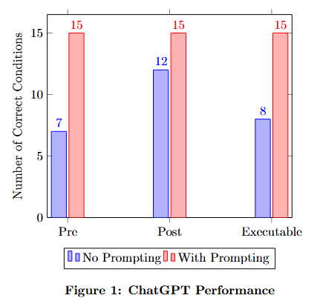
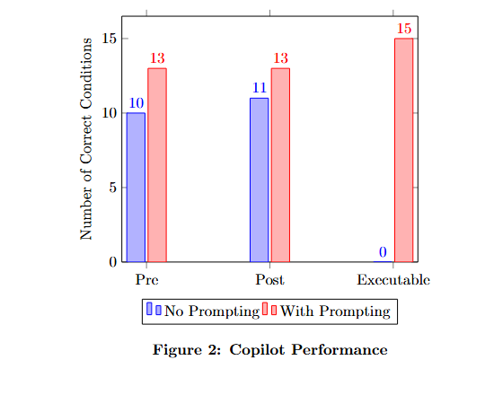
Results
Notes:
This wasn’t asked for in the assignment, but here are the results of my ‘research’ I was surprised to say the least.

